Slide 1
Heart Disease and Risk Analysis
CIS: 500 Decision Testing and Data Analysis
Team Members:
Mohit Thakar (SUID: 450607855)
Kavya Shah (SUID: 330126500)
Sohan Thakur (SUID: 578607587)
Syracuse University

Slide 2
OUTLINE
Background Information
Abstract - Problem Statement & Significance
Problem Description
Existing Analysis Method
Data Overview
Developed Analysis & Outcomes
Developed Method
Conclusions
Future Scope
References

Slide 3
BACKGROUND INFORMATION
Heart disease is one of the leading causes of death in the US that claims thousands of lives annually.
The impact of this extends beyond mortality, by putting burden on the individuals and healthcare systems with significant socio and economic costs.
There are multiple factors leading to heart diseases that range from demographic factors such as age, gender, family history, genetics to modifiable factors such as high blood pressure, high cholesterol, sedentary lifestyle, alcohol consumption, smoking, etc.
Various organizations such as American Heart Association (AHA), American College of Cardiology (ACC) and European Society of Cardiology (ESC) regularly update guidelines and give recommendations on how an individual can lower their risk of heart disease and maintain a healthy lifestyle.

Slide 4
ABSTRACT - PROBLEM STATEMENT
Cardiovascular diseases poses a significant public health concern, that necessitates a holistic approach to understand its causes and risk factors at early stage.
Our project aims to analyze the impact of various lifestyle factors on heart disease risk among patients.
We have utilized a dataset that comprises of key variables such as age, cholesterol levels and lifestyle habits, to uncover the patterns and correlation for early detection and prevention.
Our focus areas includes factors such as age-related risks, cholesterol levels, blood pressure, and lifestyle choices including alcohol consumption, exercise habits, and dietary patterns.
The overall goal is to provide valuable insights into the complex interplay between lifestyle choices and heart disease risk.

Slide 5
ABSTRACT - SIGNIFICANCE
Enhanced Early Detection
Personalized Prevention Strategies
Improved Public Health Policies
By analyzing the impact of various lifestyle factors alongside the traditional risk factors, this early detection is crucial for implementing timely interventions and preventing the progression of the disease.
Tailoring interventions to individual patients based on their risk profiles could lead to more effective and targeted approaches for reducing the risk and severity of the heart disease.
The insights generated by our research might help development of public health policymakers to identify modifiable lifestyle factors that contribute to the disease and implement targeted interventions to promote healthier behavior and reduce overall disease impact.

Slide 6
PROBLEM DESCRIPTION
Objective: Our objective is to explore and quantify the impact of a spectrum of health and lifestyle factors on the risk of heart disease in individuals. This study aims to validate the hypothesis that negative lifestyle habits are associated with an increased risk, while positive habits correlate with decreased risk.
Focus Areas: The study will focus on critical factors such as age, gender, cholesterol levels, family history,etc of heart disease, and patient demographics. Lifestyle variables including alcohol consumption, exercise frequency, dietary patterns, stress levels, and sedentary behavior will also be scrutinized for their roles in heart health.
Hypothesis: It is predicted that a convergence of unhealthy lifestyle choices, characterized by high alcohol intake, excessive smoking, and advanced age, will elevate heart disease risk. Conversely, healthy habits are expected to mitigate this risk.

Slide 7
EXISTING ANALYSIS METHOD
Existing methods may exhibit limitations in accurately predicting heart disease risk, particularly in diverse patient populations or when considering complex interactions between risk factors.
Interpretability results may be challenging, hindering clinician's ability to understand and act upon risk predictions effectively.
Scalability issues may rise when applying these methods to large-scale datasets or integrating them into routine clinical practices, potential impacting their utility and feasibility.
Improvement in risk assessments methods can enable earlier detection of heart disease, leading to timely interventions and preventive measures.

Slide 8
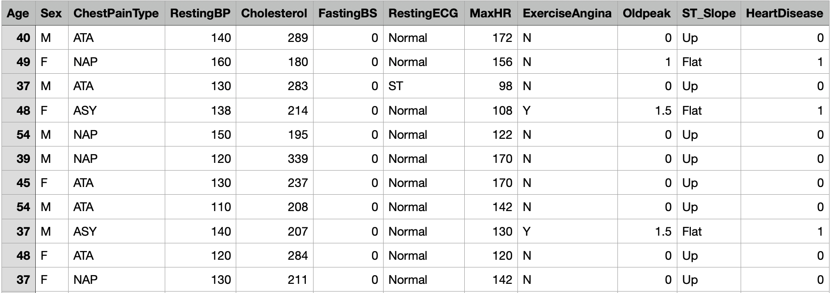
DATA OVERVIEW

Slide 9

Developed Analysis and Outcomes

Slide 10
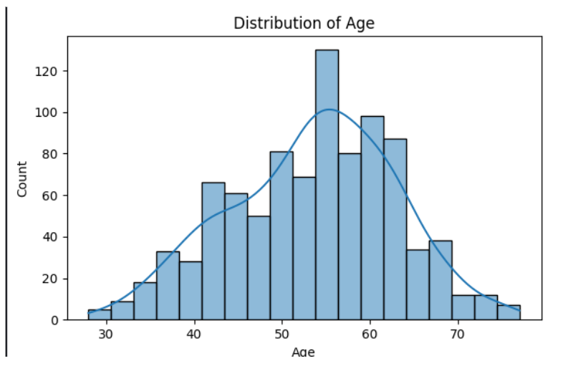
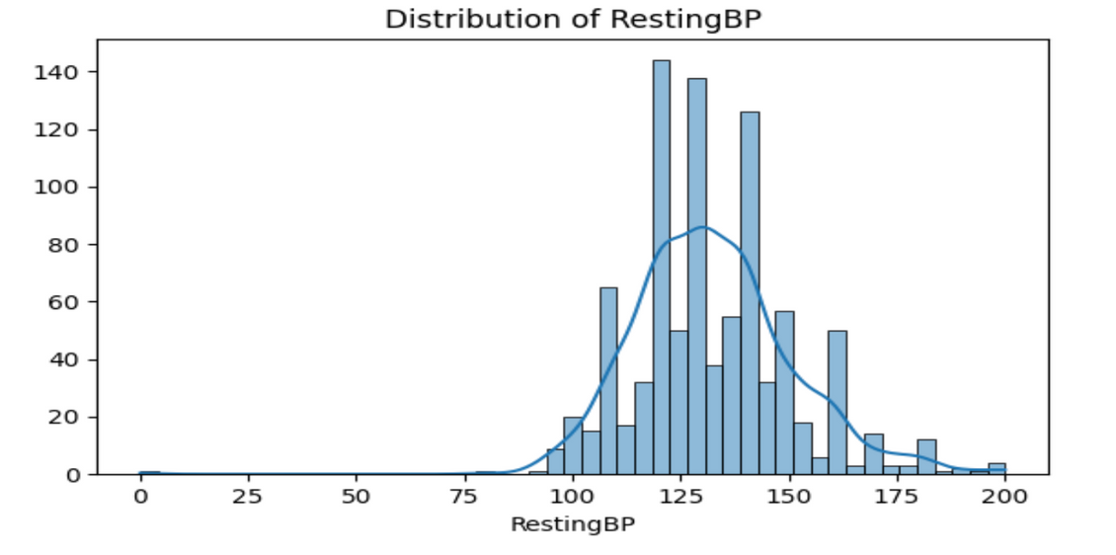
FREQUENCY DISTRIBUTIONS
The Histogram shows the distribution of Age. The graph indicate that distribution is normal with slight rights kew, which suggest a large proportion of middle-aged to elderly individuals. Age between 50 to 60 is the most common range in dataset.
2. The above Histograms shows the distribution of Resting Blood Pressure which display a distribution that is approximately normal but with several spikes that indicate blood pressure values increment. Common range is 120-140, which is consider ae the normal range for resting blood pressure.

Slide 11
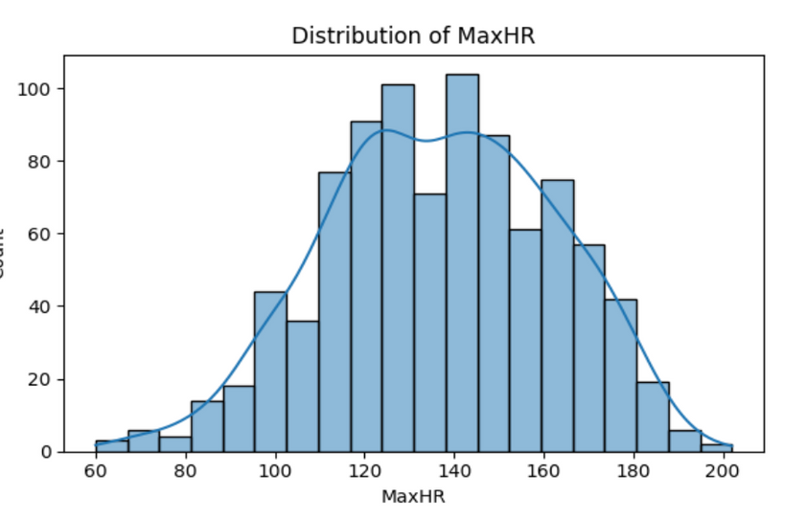
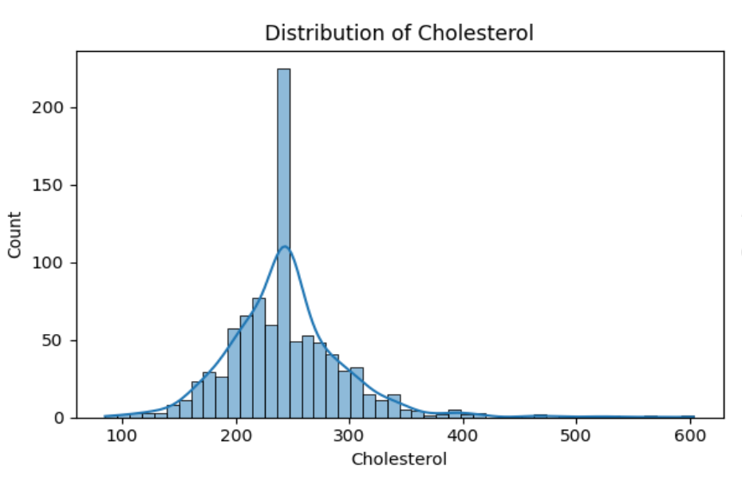
FREQUENCY DISTRIBUTION
The above two graph shows Cholesterol level distribution and Maximum Heart Rate distribution.
Observation for Distribution of Cholesterol: The dataset are right-skewed, which says that most values peaking around 200 to 250, indicating of borderline high cholesterol, where as the tail showing fewer individuals with high level.
Observation for Distribution of MaxHR: The distribution is normal with slight left skew. Common values are clustered around 140-160 beats per minute. It says, the heart’s ability to reach high rates during exercise and the overall spread suggest a variation in cardiovascular fitness among the individuals.

Slide 12
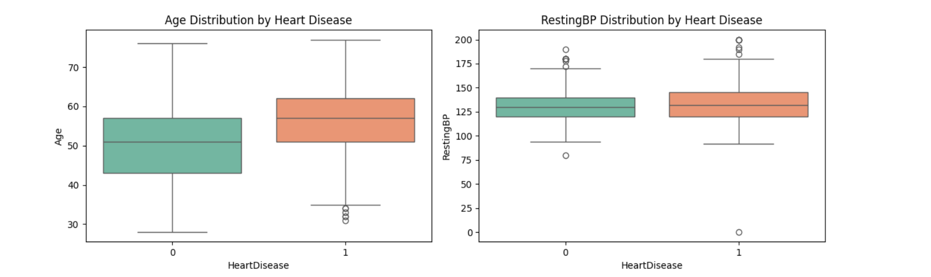
2. DISTRIBUTION BY HEART DISEASE
The above box plots are for Age Distribution by Heart Disease and RestingBP Distribution by Heart Disease. (0) indicates without heart disease and (1) Indicate with heart disease.
Observation for Age Distribution by Heart Disease: Central line indicate the median age of the group. It shows, the median age of individuals with heart disease is higher than those without. Middle 50% of ages for each group falls within the boxes, and the lines extending from the, called whiskers, display the full age range, excluding a few outliers as shown by the separate(round) points.’
Observation for RestingBP by Heart Disease: It shows that the people with heart disease tend to have a slight higher median resting blood pressure than those without. The boxes show the most common blood pressure ranges, and points outside the lines (whiskers), represent the outliers.

Slide 13
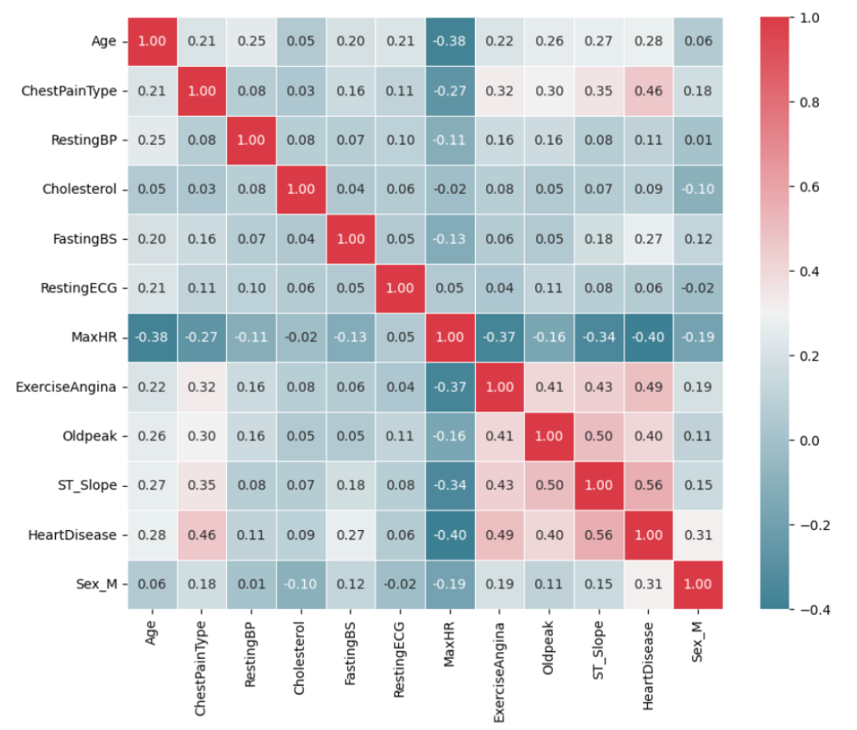
3. CORRELATION ANALYSIS
MaxHR (Maximum Heart Rate) for Age: The strong negative correlation coefficient of -0.38 suggests that as age increases, the maximum heart rate tends to decrease. This could indicate age-related changes in cardiovascular function, where older individuals generally exhibit lower maximum heart rates compared to younger individuals.
HeartDisease for ChestPainType: The correlation coefficient between HeartDisease and ChestPainType is 0.46, indicating a strong positive correlation. This implies that there is a significant association between the type of chest pain experienced by individuals and the presence of heart disease.
Oldpeak for ST_Slope: The correlation coefficient between Oldpeak (ST depression induced by exercise relative to rest) and ST_Slope (the slope of the peak exercise ST segment) is 0.50, indicating a moderate positive correlation. This suggests that a higher degree of ST depression is associated with a more pronounced slope of the peak exercise ST segment.

Slide 14
4. PREDICTION
In our project, employing logistic regression yielded and accuracy of 82.61%. This accuracy metric indicates the proportion of correctly predicted outcomes by our model out of all the samples in the test dataset, In other words, our model accurately classified 82.61% of the individuals as either having a possibility of developing heart disease or not.
Logistic Regression is a statistical model which is used to forecast the likelihood of a binary outcome based on one or more predictor variables in classification.
In other words, we can say that it helps in our understanding of how variations in factors such as age, cholesterol, blood pressure, alcohol consumption etc. affect our chance of developing or having a heart disease.
We employed logistic regression in our project in order to determine an individual’s risk because our study involves a binary categorization of whether an individual has a possibility of developing heart disease or not. For obtaining such binary results, our machine learning approach is therefore quite appropriate.
It offers coefficients that shows how much the independent variable affects the likelihood of developing the condition. For instance, a positive age coefficient indicates a higher risk of cardiovascular disease with advancing age.
It assist in determining the clinical terms that are most relevant to analysis and predict precisely.
It helps is evaluating our model in terms of accuracy metrics so that we can determine how well our model performs on the unseen data and make improvements and adjustments if needed in future.

Slide 15
DEVELOPED METHOD
Data Collection: Obtained heart disease dataset from Kaggle contaning information on various patient attributes, including smoking habits, cholesterol levels, blood pressure, age, chest pain type, resting BP, etc.
Data Preprocessing: Applied data preprocessing techniques, including label encoding to convert categorical data to numerical ones. For instance, we mapped chest pain types to numerical data on the basis of the severity levels of their type.
Descriptive Analysis: Conducted exploratory data analysis (EDA) to understand distribution of the data within the dataset. Visualizations such as histograms and bar plots were used to explore the numerical categorical values
Correlation Analysis: We calculate the correlation matrix to indetify the relationships between different attributers, such as chest pain type, cholesterol levels and heart disease risk. A correlation heatmap is used to visualize the correlation coefficients.
Prediction: We have utilized logistic regression to classify whether a patient is at a risk of heart disease. The datset was spllit into training and testing sets, and a logistic regression model was trained on scaled data. Predictions made on the test set, and accuracy of the model was evaluated.

Slide 16
CONCLUSIONS
The model predicts that when a patient has age, high cholesterol levels, blood sugar, severe chest pain, resting BP, then a heart disease of 1 indicates that the patient is at a higher risk and may require immediate medical attention.
On the other hand, factor such as high max heart rate is inversely proportional to risk of developing a heart disease.
Analysis conveys attributes such as Chest Pain Type, Exercise Angina and ST_Slope, OldPeak significant contributors towards heart disease.

Slide 17
FUTURE SCOPE
More data…
Expand models to incorporate environmental factors such as air pollution, behavioral factors such as diet, physical activity, family history can also be considered to improve our prediction.
Poor mental health and sleep patterns have independently linked towards heart disease and hence these factors should also be considered.
We can monitor an individual’s healthcare access and how frequently they use medical services that can benefit in detecting heart conditions early.

Slide 18
REFERENCES
[1] https://www.kaggle.com/datasets/fedesoriano/heart-failure-prediction
[2] https://lost-stats.github.io/Presentation/Figures/heatmap_colored_correlation_matrix.html
[3] https://en.wikipedia.org/wiki/Pearson_correlation_coefficient
[4] https://en.wikipedia.org/wiki/Logistic_regression
[5] https://www.ncbi.nlm.nih.gov/pmc/articles/PMC9573101/
[6] https://www.heart.org/en/health-topics/high-blood-pressure/why-high-blood-pressure-is-a-silent-killer/know-your-risk-factors-for-high-blood-pressure

Slide 19
THANK YOU
By
Mohit
Kavya
&
Sohan

